Slide 1

Meet your Mate !
Mindful
Approach to
Transactions &
Expenditure

Slide 2
"I can't find anywhere in our app to plan my budget ."
--Lloyds colleague with ADHD
Notes:
After talked to several colleagues who has ADHD, they gave us some really useful insights of what our lloyds banking app currently lacking and what they think would be helpful.
One colleague said she can't find anywhere in our app to plan her budget, there is no way to difficiate what is planned purchases and unplanned purchases.

Slide 3
AGENDA
IDEA
ARCHITECTURE
DEMO
FUTURE WORK

Slide 4
💡THE IDEA
BUDGETING
TRANSACTION FRICTIONS
EMOTION TRACKING
Notes:
So MATE aims to help with these problems by providing these three options.

Slide 5
PERSONAL JOURNEY (PROBLEM STATEMENT)
As a customer,
I want my banking app to help me manage my spending
so that I can meet my financial goals

Slide 6

PERSONA: MEET CLAIRE
Profile: 34 years old, Marketing Manager, Annual Income: £48,000, Take home pay: £2800/month
Financial Context: Renting with partner, saving for first deposit has joint account for regular monthly expenses
Challenges: Uncontrolled discretionary spending, frequent impulse purchases, difficulty tracking expenses
Primary Goal: Reduce impulse buying, improve purchase tracking, save for house deposit

Slide 7
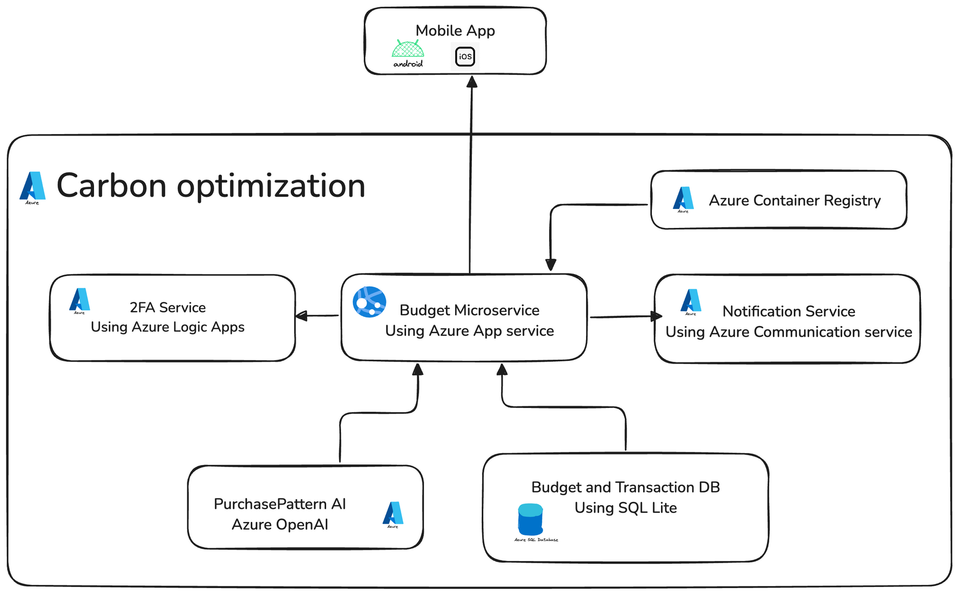
ARCHITECTURE & USE OF TECHNOLOGY

Slide 8
DEMO

Slide 9
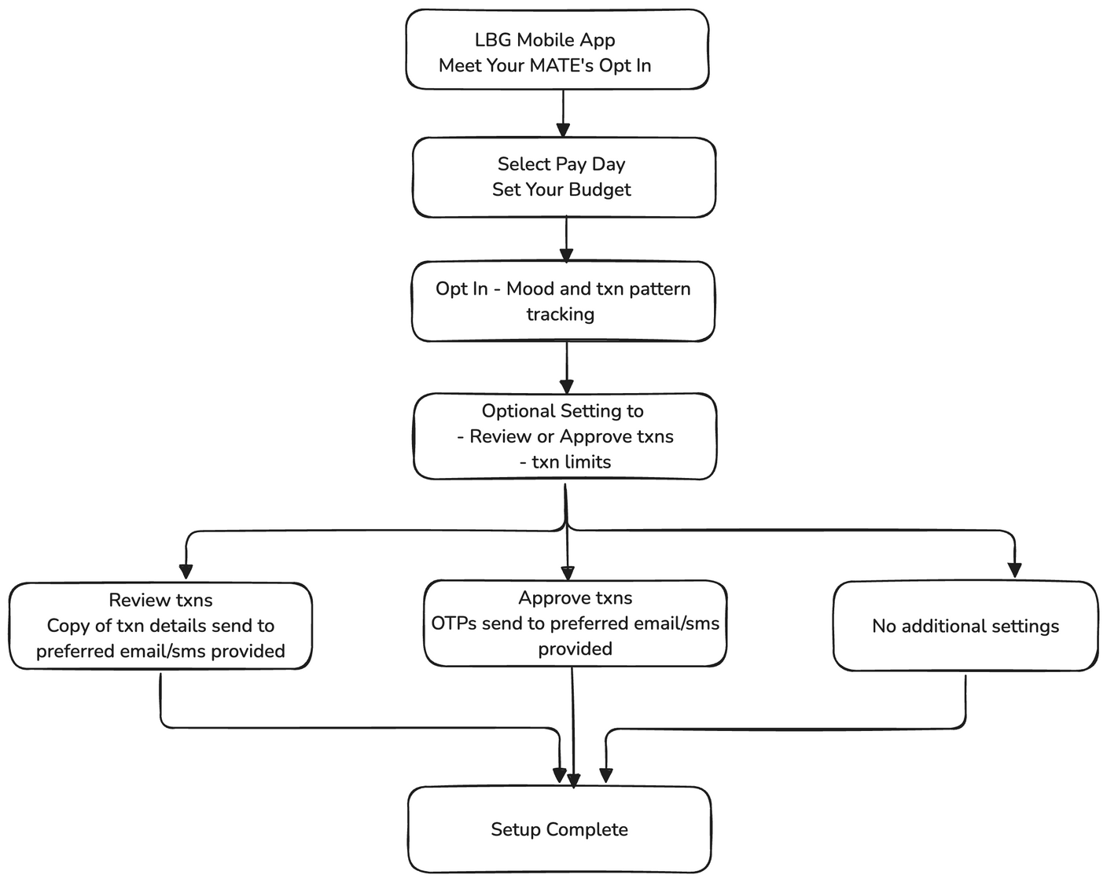
STEP 1: SET YOUR BUDGET
Notes:
this is the work flow of the user journey, too much text so let's see the video demo

Slide 10
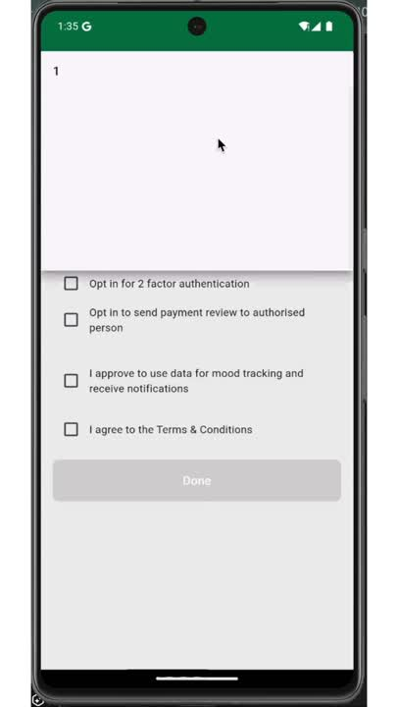
STEP 1: SET YOUR BUDGET (DEMO)
Notes:
and here you can opt in 2 factor authentication, this is the function that allows you have an extra friction when having unplanned purchases, you need the code that send to your trusted person to compete the purchase, which will show later.

Slide 11
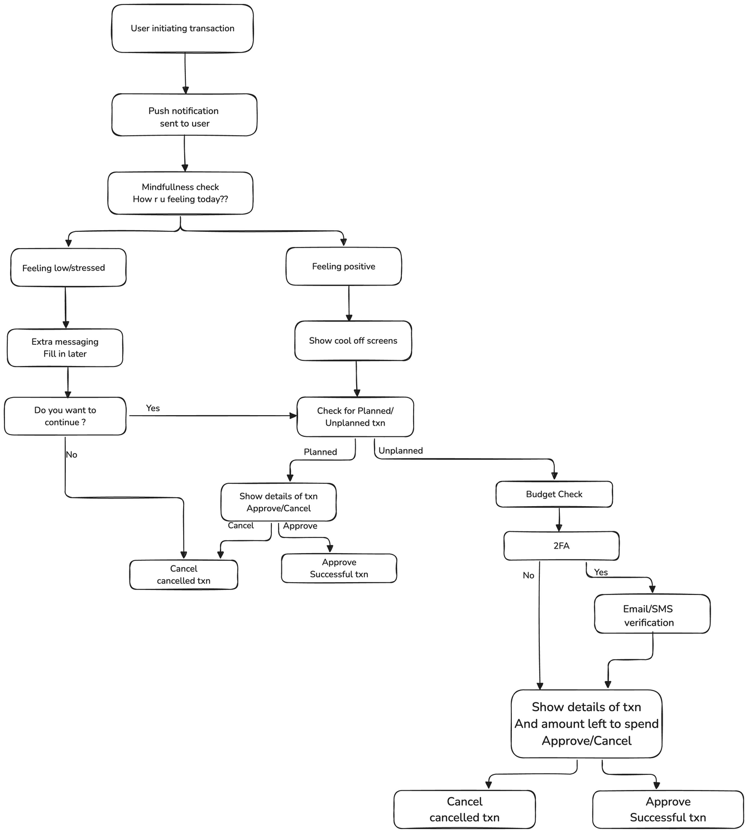
STEP 2: USER TRANSACTION JOURNEY

Slide 12
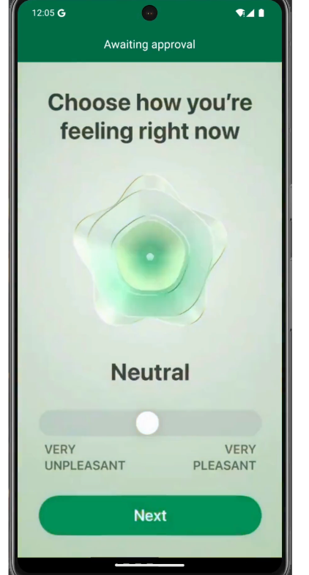
STEP 2: PAY WITH MINDFULNESS
Before approve each transaction, MATE will quickly ask you how are you feeling right now.
In the future, we'll have personalised checkin page according to user's spending behaviour.
Notes:
if you opt in our mindful checkin,

Slide 13
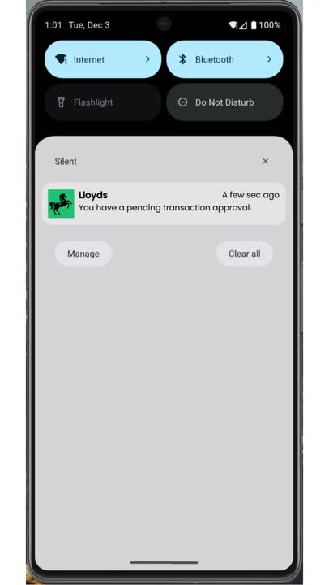
STEP 3: USER ONLINE TRANSACTION JOURNEY
Notes:
Here is the whole user only transaction journey

Slide 14
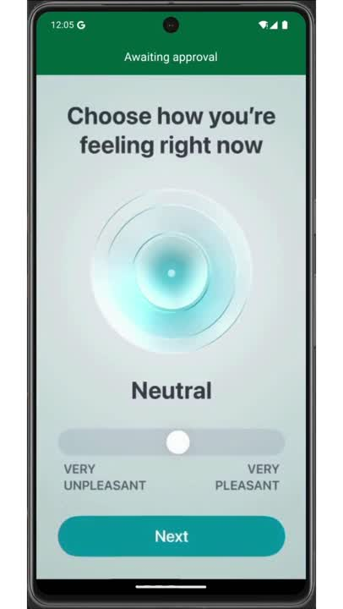
STEP 3: USER OFFLINE TRANSACTION JOURNEY
Notes:
off line transaction journey is for example you have a purchase in store using contactless, you wouddn't be able to approve or decline the purchase, but you can choose your feelings and categorise it after the transaction complete

Slide 15
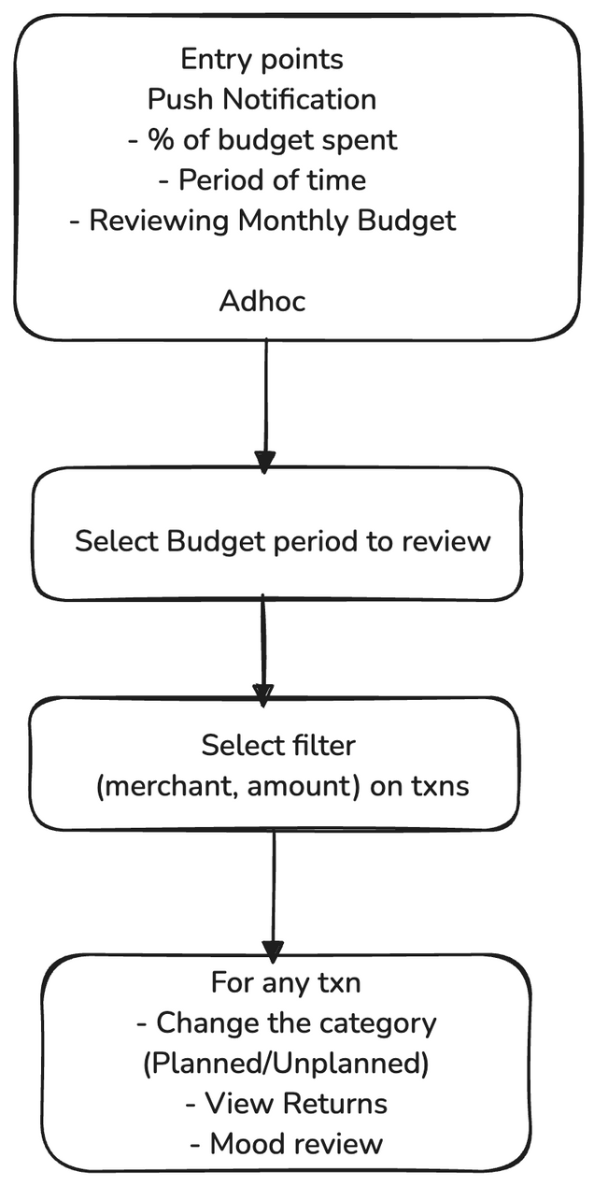
STEP 4: REVIEW TRANSACTION HISTORY

Slide 16
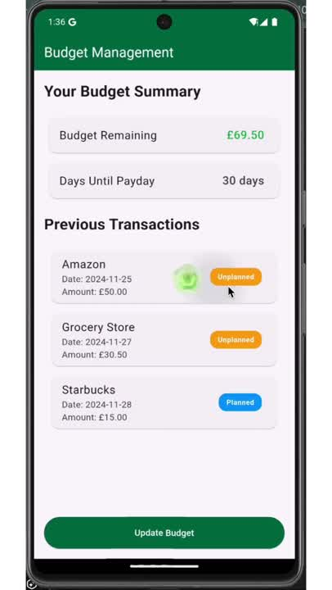
STEP 4: REVIEW TRANSACTION HISTORY
Notes:
After a week or a month, maybe you'll change your ideas about planned or unplanned, so MATE also provide option to review the transaction history, you can change planned to unplanned, and you can check your mood tracking.

Slide 17
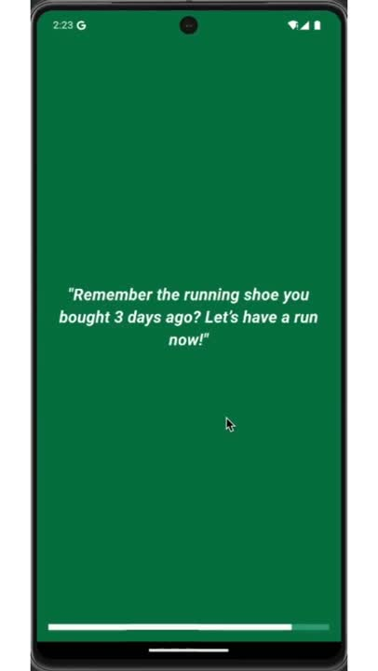
STEP 5: PERSONALISED COOLDOWN MESSAGES
Notes:
Remember the cooling down page? we want to make it better, so introducing personalised cooldown messages, in the future we want to use AI to learn the transaction patterns and give personalised messages.
It gave some useful activity suggestions instead of online shopping.

Slide 18
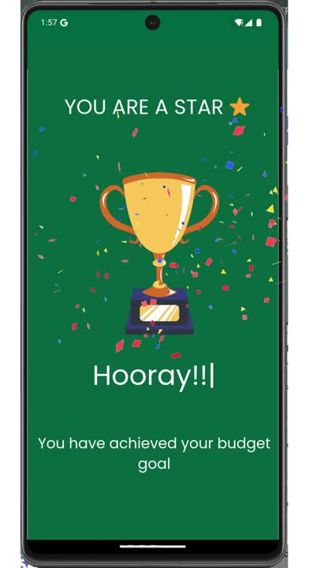
STEP 6: GOAL COMPLETE ACHIEVEMENT
Notes:
Finally, we all need some pat on the shoulder, if you are doing a good job budgeting this month, a notification will send your phone saying.
after you click it, it will remind you , you are a star by achieving your budgeting goal, hooray!!

Slide 19
FUTURE WORKS
1. Incorporate planned and unplanned category with Spending Insight Journey platform to enhance categorisation.
2. Send personalised notification intervals for mood check-in.
3. Incorporate return policy of the purchase in transaction details
4. If a user consistently underspends, we suggest creating savings goals, like a home or travel fund, and recommend relevant LBG products, such as mortgage advice, to support their financial growth.
Notes:
Give Personalised notification intervlas for mood check-in. it can be quarter over your budget, half way, so you'll have a comparision of how you felt before the transaction, compare to how you feel after maybe couples of weeks.

Slide 20
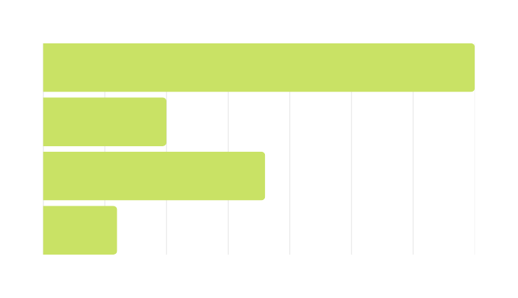
CARBON IMPACT
Single T-shirt
7 Kg CO2
Pizza
2 - 11 Kg CO2
Parcel Delivery
3.6 Kg CO2
Parcel Return
1.2 Kg CO2
Infrastructure
Utilise Azure Carbon Optimisation to measure and minimize Azure carbon footprint
Finetune smaller AI models to reduce the overall footprint
User
Returns from online purchases are double to quadruple that of physical store returns [1]
https://www.nature.com/articles/s41558-021-01246-9
https://www.money.co.uk/guides/dirty-delivery-report-2020
https://www.mdpi.com/2071-1050/14/5/3125#:~:text=The%20average%20mass%20of%20the,%2C%20and%20home%2Dmade%20pizzas
https://www.carbonfact.com/blog/tshirt#:~:text=A%20t%2Dshirt%20is%207%20kg%20of%20CO2%20equivalent%20on%20average.&text=The%20average%20carbon%20footprint%20of,in%20India%20(10%20kgCO2e)..
https://blog.cleanhub.com/ecommerce-returns-environmental-impact#:~:text=The%20carbon%20emissions%20associated%20with,human%20health%20and%20the%20environment.
Notes:
7 kg of CO2e emissions for a T-Shirt
2kg - 11.5kg for a pizza
10% of the carbon emissions comes from items returned to a store. Returns from online purchases are double to quadruple that of physical store returns

Slide 21
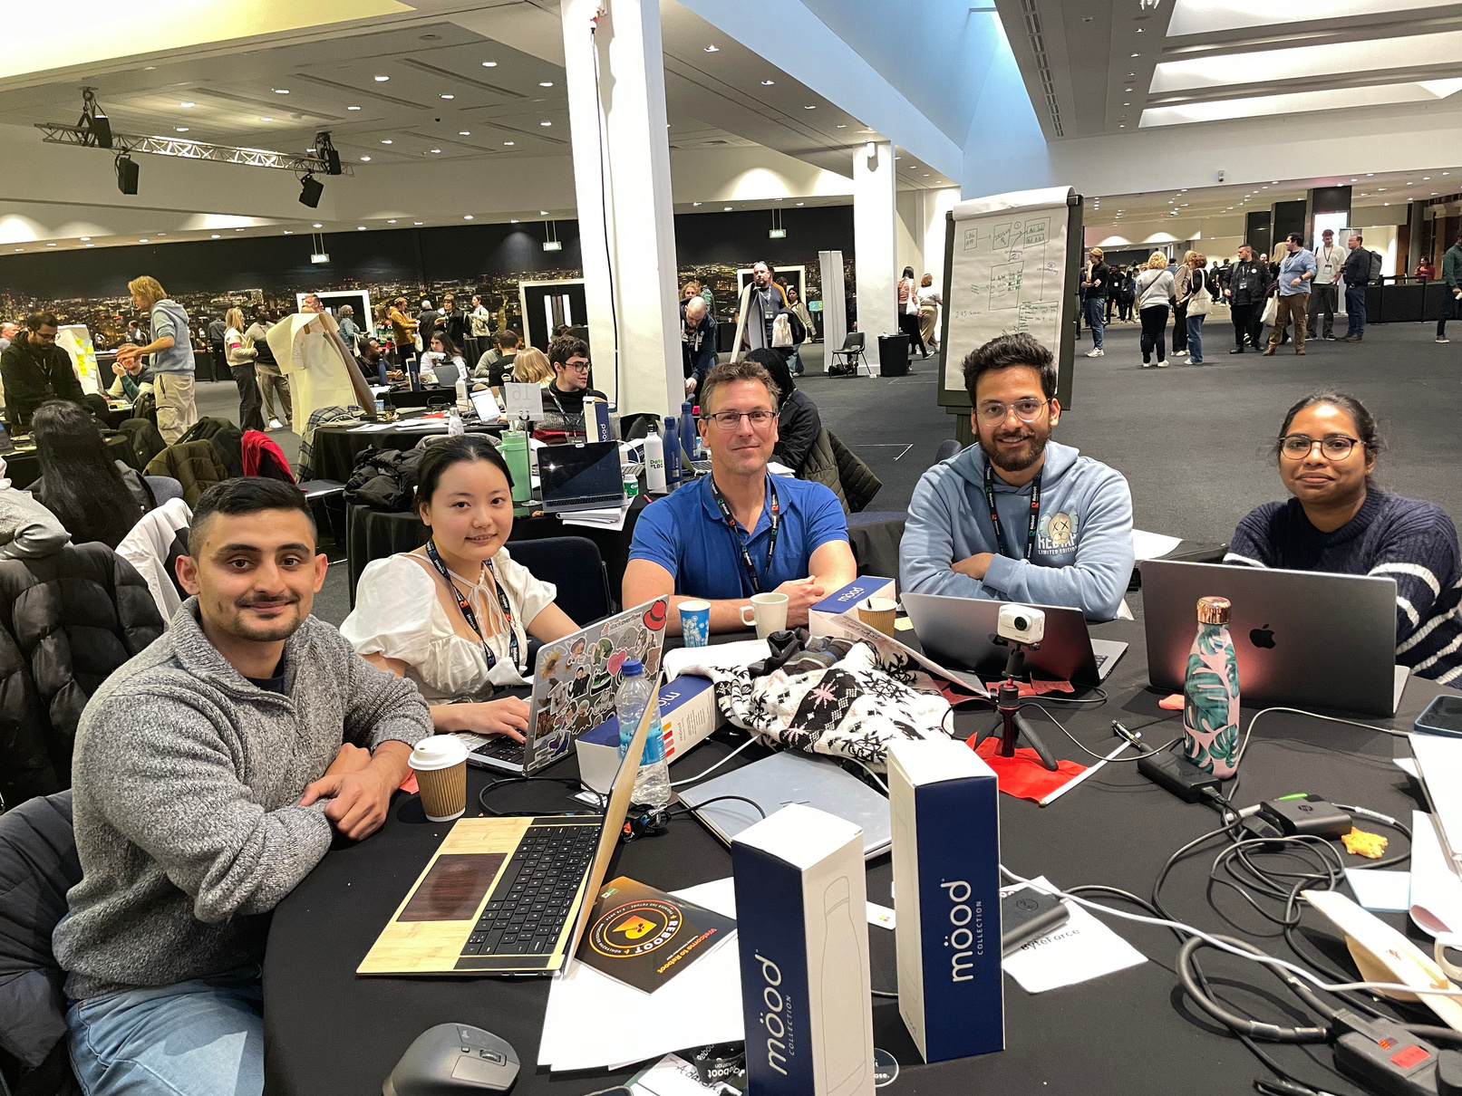
MEET THE TEAM
Notes:
Lastly shout out to the brilliant team who worked together today.
And the colleagues we talked to these past few weeks, ( Sophie, James, Joe) who validated our ideas that we are not blindly building something far off, and gave us extremely useful insight of their experiences.

Slide 22
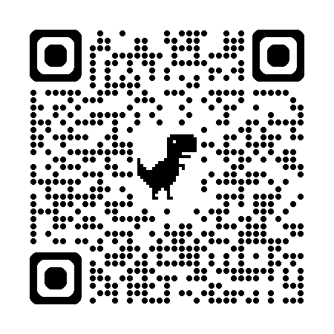
ACCESS AZURE BACKEND SERVICE

Slide 23

Let’s build a future for everyone, With MATE, empower yourself to budget mindfully, stay prepared, and thrive—on your terms."
Ingoude Company

Slide 24
Thank you!

